Slide 1
Week 7 Development 6a - Algoritmiek
INFDEV016A
Giulia Costantini, Francesco Di Giacomo, Giuseppe Maggiore
costg@hr.nl – Office H4.204

Slide 2
Today
Why is my code slow?
Empirical and complexity analysis
How do I order my data?
Sorting algorithms
How do I structure my data?
Linear, tabular, recursive data structures
How do I represent relationship networks?
Graphs

Slide 3
Dynamic Programming
Fibonacci sequence, Memoization, Bottom up, General idea

Slide 4
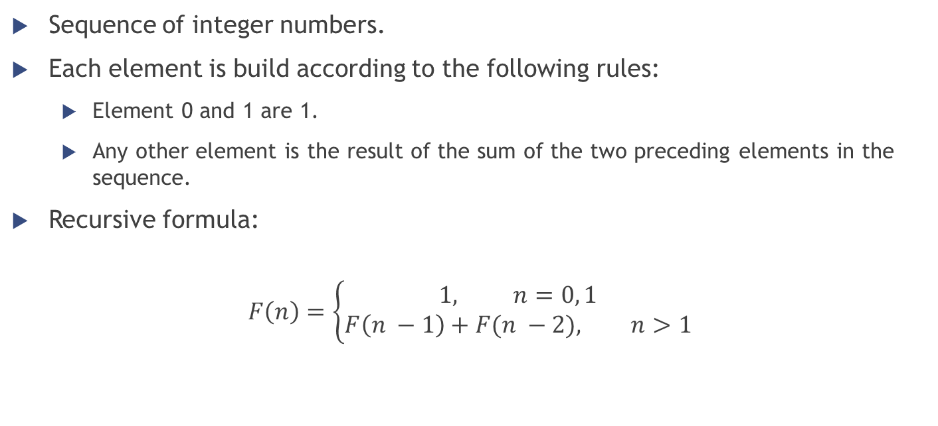
Fibonacci Sequence Definition
Sequence of integer numbers.
Each element is build according to the following rules:
Element 0 and 1 are 1.
Any other element is the result of the sum of the two preceding elements in the sequence.
Recursive formula:
$$F\left(n\right)=\left\{\begin{aligned}1, n=0, 1 \\ &F\left(n −1\right)+F(n −2), n>1\end{aligned}\right.$$

Slide 5
Fibonacci Sequence Recursive function
Fibonacci(N) IF N = 0 or N = 1 return 1 ELSE return Fibonacci(N - 1) + Fibonacci(N - 2)
N | Time(ms)
30 | 4
35 | 50
40 | 551
45 | 3792
>50 | Happy watching!

Slide 6

Fibonacci Sequence Why so slow?
F(5)
F(4)
F(3)
F(3)
F(2)
F(2)
F(1)
F(2)
F(1)
F(1)
F(0)
F(1)
F(0)
F(1)
F(0)
Complexity = $O(2^{n})$

Slide 7
Fibonacci Sequence Why so slow?
“Did I ever tell you what the definition of insanity is? Insanity is doing the exact... same *** thing... over and over again expecting... things to change...”
We are doing the same thing over and over again.
We compute F(3) twice, and F(2) three times.
Why don’t we save the result of sub-problems?

Slide 8
Fibonacci Sequence Memoization
Save the result of sub-problems into a data structure.
The data structure is called lookup table.
Before we make a recursive call check the lookup table.
Missing: make the recursive call.
Present: read the result from the table.
Add the result of the current recursive call to the lookup table.

Slide 9
Fibonacci Sequence Memoized algorithm (recursive)
Fibonacci(N, lookupTable) IF N = 0 or N = 1 return 1 ELSE f1 = 0 f2 = 0 IF lookupTable[N - 1] = -1 f1 = Fibonacci(N – 1, lookupTable) ELSE f1 = lookupTable[N - 1] IF lookupTable[N - 2] = -1 f2 = Fibonacci(N – 2, lookupTable) ELSE f2 = lookupTable[N - 2] lookupTable[N] = f1 + f2 return lookupTable[N]

Slide 10
Fibonacci Sequence Memoization
We compute the sub-problems just N times.
We use an array with N + 1 elements to store the intermediate results.
Accessing the lookup table requires O(1).
The time complexity is O(N): we compute N times sub-problems that require O(1) time.
The rest requires simply to access the lookup table (constant time).
We use O(N) memory space to save the sub-problems results.

Slide 11
Fibonacci Sequence Bottom up algorithm (iterative)
Exploit the structure of the recursive calls.
Build the result of the computation starting from the base case of the recursion.
At each iteration save the intermediate results to use at the next step.
Same complexity as the recursive version.
Fibonacci(N) lookupTable = array of N + 1 elements lookupTable[0] = 1 lookupTable[1] = 1 FOR i = 2 TO N lookupTable[i] = lookupTable[i - 1] + lookupTable[i - 2] return lookupTable[N]

